Slide 1
Free Fuel Transfer
Minor improvement

Slide 2

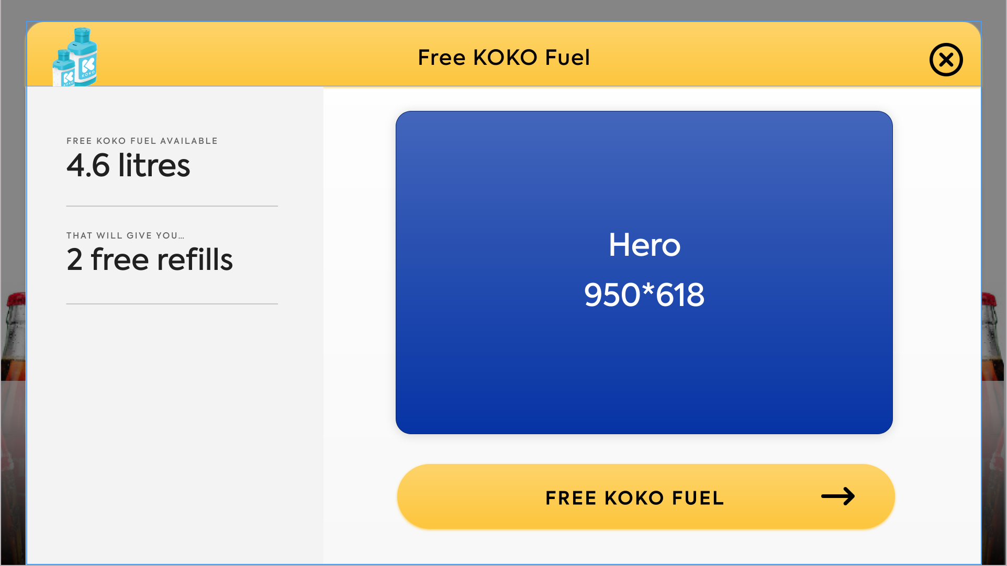
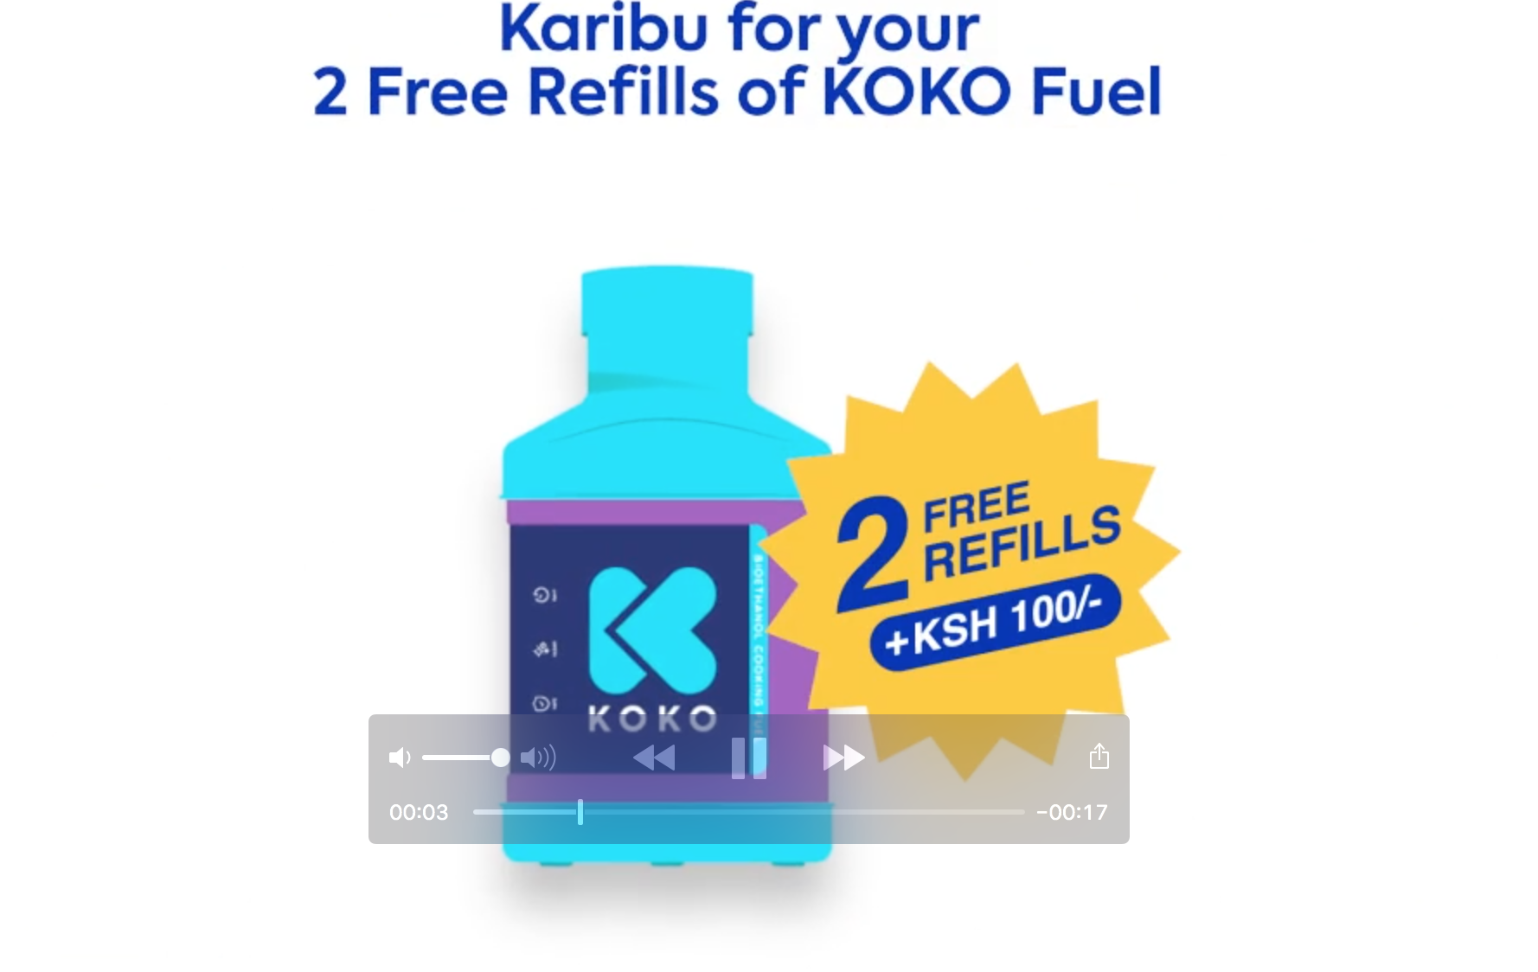
Context
Customers were delivered free fuel as part of their sign up experience.
Since then a number of customers have ‘gifted’ their cooker to another user, which is done by transferring the canister to another user.
When the cooker is gift the free fuel remains with the customer who bought the cooker, which is a waste and does not help the actual cooker user.
In addition for future fuel promotions the fuel is being given to the original customer and not the canister owner.

Slide 3
Options
 | Description | Pros | Cons
1 | When a canister is transferred automatically transfer the free fuel to the new user. | Automated Very simple | Would mean the free fuel would need to be attached to the canister in some way. Hard to transfer fuel back if customer does not want to give it away. This method doesn’t take into account why a canister is being transferred.
2 | Add free fuel to the credit / debit panel | Small change to existing function. Can be done when customer calls to transfer canister and customer is on the phone so can validate request to transfer | More work for Customer Care as this is a two step process (debit one user, then credit another).
3 | Create a transfer free fuel to another user button. | Can be done when customer calls to transfer canister and customer is on the phone so can validate request to transfer | Doesn’t solve the problem of identifying customers for promos
4 | A way to mark an individual as a gift recipient to transfer future benefits. | Allows us to identify them for future fuel promos CC can quickly tell the customer’s status. | Possibly slightly more work
Preferred

Slide 4
Option 4 - User Journey
Customer Care finds giver’s account
User clicks on unassign canister
User clicks to gift the canister
User enters phone number of recipient
Canister and free fuel are reassigned
Prerequisite: The recipient must have an account set up before theis process can be done.
Fix: Move the API call for order placement to immediately following the creation of an account (step 3)

Slide 5
Option 4 - High level design

Slide 6
Questions for Ari
Do we also need a way to be able to give free fuel to individuals and groups on an ad hoc basis?
Do we want to be able to identify gift recipients?
Do we want Cooker information back in KOKO Core and be able to transfer cookers between individuals?

